Slide 1

Year 6 residential – year 5 parents information meeting
Wednesday 14th October 2026

Slide 2
Why are we here?
We are looking to book our autumn 2027 enrichment week for our current year 5s
We have noticed a significant uplift in the number of children choosing not to go on our traditional 4-night residential (moving towards 20% of the year group)
We are aware of the cost of the trip, in difficult economic times
We would like feedback from parents and pupils prior to confirming our booking

Slide 3
What will the outcome be?
We realise that we are not going to be able to accommodate everybody’s wishes
We will use this discussion and information from a follow-up survey to make an informed decision – we never want to assume!
There will be an option to attend the chosen residential option, or take part in the Emmbrook Enrichment week in school – more information to follow

Slide 4

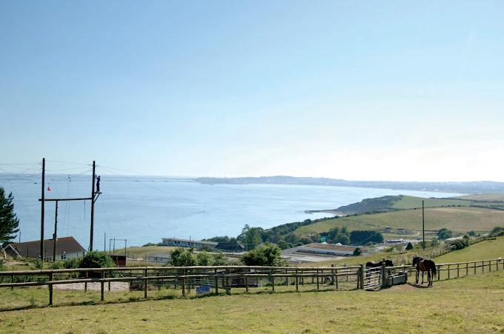
Why PGL?
Better facilities (including signal and WiFi!)
More activities
Assigned PGL group lead
Only 2 – 3 hours away

Slide 5

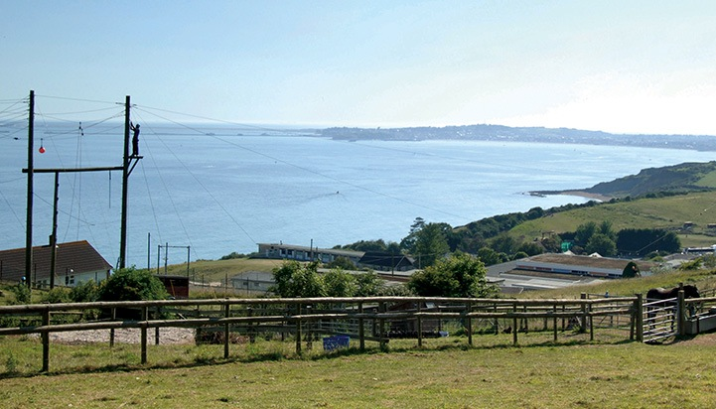
Osmington Bay
Dorset

Slide 6
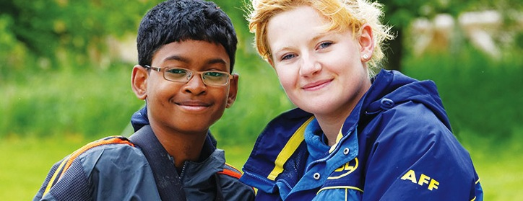




Welcome to PGL
The UK’s largest provider of outdoor education for young people
Over 55 years’ experience
Fully risk assessed
LOtC Quality Badge holder
Founding member of BAPA
ABTA bonded
Notes:
PGL provides a wide range of inspiring residential adventure and educational courses for more than 5,000 groups every year
All PGL centres and activities are risk assessed to comply with legal requirements and best practice. Risk assessments are available by request and on the PGL website
Centres are subject to the Adventure Activities Licensing Authority regulations (AALA) where appropriate
ABTA (Association of British Travel Agents) bonded means your money is protected
BAPA – British Activity Providers Association. Responsible for establishing operating guidelines for the activity holiday industry
Through the Learning Outside the Classroom Quality Badge Programme you can be confident that recognised providers fulfil all the necessary criteria as laid down by the DfE, thereby better enabling Party Leaders to manage visits safely, efficiently and beneficially

Slide 7


Slide 8
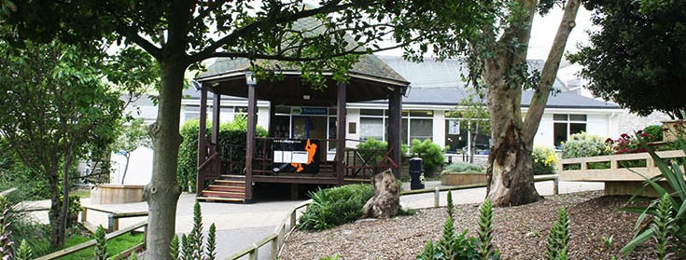

LEARNING OUTSIDE
Osmington Bay - Dorset
27 fantastic adventure activities to choose from
Direct access to the beach
Watersports take place at the Portland Bay Olympic venue nearby
Explore the 360 Virtual Tour www.pgl.co.uk/osmington360 to see inside the centre and view activity information and videos

Slide 9

The PGL difference
Dedicated PGL Tour Leader to provide support throughout stay
Tailored excursion programme to cultural places of interest
Free on-site adventure activities
Evening entertainment programme
24 hour support from centre team
Notes:
Your PGL Tour Leader will have a wealth of local knowledge so you can make the most of your time away.

Slide 10
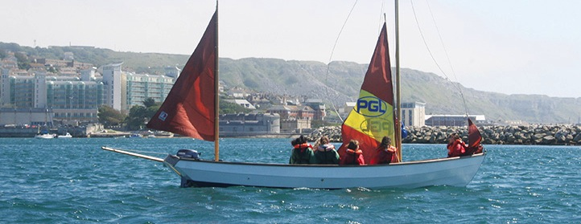
Adventure activities
Abseiling
Aeroball
Archery
Beach Walk
Climbing
Dragon Boating
Fencing
First Aid
Giant Swing
Hiking
Jacob’s Ladder
Kayaking
Keelboat Sailing
Low Level Ropes Course
Mountain Biking
Orienteering
Problem Solving
Quad Biking
Raft Building
Rifle Shooting
Sensory Trail
Sports and Team Games
Street Surfing
Survivor
Trapeze
Tunnel Trail
Zip Wire
Notes:
The activities shown offer individual as well as team challenges
Watersports take place at the Portland Bay Olympic venue nearby
Activities are designed to encourage new skills and develop existing ones
Specific activities can be requested (though not guaranteed) and the programme is discussed on arrival at the centre

Slide 11
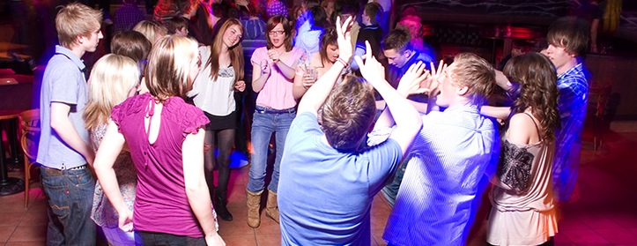
Evening entertainment
£1 drop
50/50
Ambush
Campfire
Capture the Flag
Casino Night
Cluedo
Disco
Family Fortunes
Geocaching
Karaoke
Night Hike
Olympics
Osmopoly
Passport to the World
Pirate Challenge
Robot Wars
Snapchat Challenge
Splash
Sports Night
Superhero Action
The Cube
Wacky Races
Young Apprentice

Slide 12
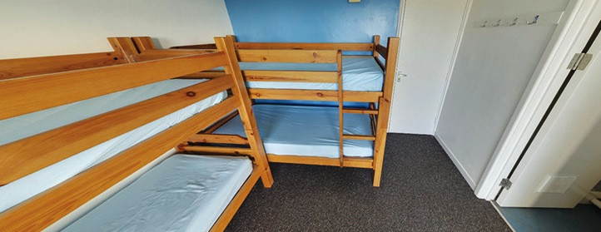
Accommodation
Purpose-built chalets
En suite rooms sleep 4-6
Accommodation for Osmington Bay can be viewed in the 360 virtual tour: http://www.pgl.co.uk/osmington360
Notes:
The centre can accommodate 800 guests at a time with accommodation in the en suite chalets
Teachers are usually accommodated in twin rooms with en suite and hot drink facilities
All rooms are lockable (party leader given master key)
All exterior doors and gates are locked at night but can be opened from the inside in an emergency without the need for unlocking
A PGL staff member is available on duty throughout the night (contactable by phone)
The extensive facilities (other than activity bases) are available to your group during free time

Slide 13
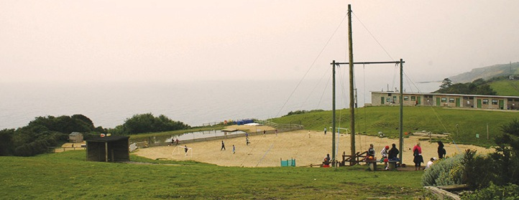
Facilities
Direct access to the beach
Sports hall
Indoor Activity Zone
ICT facilities
On- and off-site adventure activities
Disco
Shop
Classrooms / meeting rooms

Slide 14
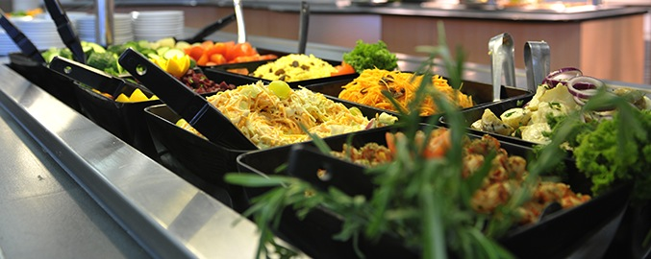
Catering and dietary needs
3 nutritious, balanced meals per day
Self-service salad bar
Vegetarian option
Special diets catered for by prior arrangement
Sample menus available online: www.pgl.co.uk
Notes:
We continually invest in healthy menus with freshly cooked ingredients obtained from fully traceable audited suppliers
Processed food is avoided and meals meet Local Authority guidelines
There will be hot and cold options available at every meal
At lunch and dinner the buffet includes a salad bar and mixed fruit basket plus hot and cold drinks
Our caterers can deal with most dietary requirements but please ensure the party leader is aware of any dietary requirements well in advance
More food is always available if required

Slide 15
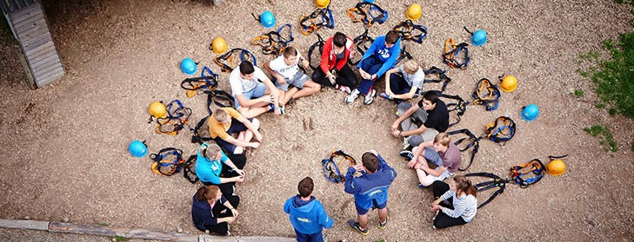
Health & safety
The PGL Code of Practice describes all safety and operational procedures both on and off-site including:
Sample risk assessments
Staff-to-pupil ratios
Operating procedures
Staff vetting & training
Site security
First Aid procedures
Emergency procedures
www.pgl.co.uk/cop
Notes:
Please see Code of Practice for further detail
All centres and activities are fully risk assessed every year
The PGL Code of Practice details all the control measures put in place to minimise risk
Sample risk assessments are available on line and specific assessments are available from PGL on request
Staff-to-pupil ratios comply with recognised industry standards
Operating procedures all comply with recognised industry standards and National Governing Body guidelines where these are relevant
PGL recruitment officers have extensive experience at a senior level on centre and make selections based on a detailed application form
Two formal written references are taken and applicants have to provide documentary evidence of all qualifications claimed
All offers of employment are subject to DBS checks, the successful completion of pre-employment training and a favourable probationary period
All our instructors are specifically trained for our programmes to ensure the delivery of safe and rewarding sessions across a wide range of activities
At every PGL centre there is an experienced and professional Centre Manager (supported by Senior Staff) who is in charge of centre operations and has overall responsibility for the success of the course and the performance of our staff
It is the policy of PGL to take all reasonable steps to ensure the safety and security of all guests and staff on our centres (details in Code of Practice)
Each centre has at least two First Aid staff who hold the “First Aid at Work” qualification and in addition all our instructors and group leaders complete an 8 hour first aid course. Party Leaders and teachers will ultimately remain responsible for the administration of first aid to their party members
There are rigorous general accident and emergency procedures in place
Through the Quality Badge Programme you can be confident that recognised providers fulfil all the necessary criteria as laid down by the DfE, thereby better enabling Party Leaders to manage visits safely, efficiently and beneficially

Slide 16
An alternative – Oakwood challenge
A school residential at Oakwood will be jam-packed with outdoor activities, fun and great memories for children from year 2 onwards.
The recently refurbished residential accommodation can house up to 68 guests in 12 en-suite rooms during the winter months. An additional 32 guests can be housed in our adventure tents during the summer months. These tents will give you a feeling of being out in the wilds with all the comfort of cosy camping. they are practically styled with raised beds, comfy mattresses, a seating area, lighting and power sockets. The Adventure Tents also have their own patio with a toilet and shower block nearby.
Other residential facilities include a fully equipped kitchen, a dining room and a lounge in which to relax, play table tennis or table football. There is also ‘The Octagon’, a large stand-alone building which can comfortably hold up to 150 people. It is a great versatile space in which to hold evening activities such as quiz and movie nights.

Slide 17
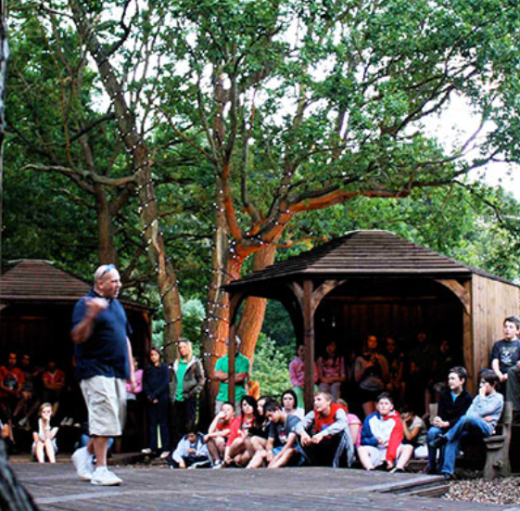
Oakwood activites:
High Ropes
Archery
Climbing
Lead of Faith
Mountain Biking
Flying Kiwi
Abseiling
Jacob’s Ladder
Crate Staking
Bush Craft… and more!

Slide 18
How must will it cost?
Total Cost per child: around £460
(for 2 night options, it will be between £230 and £300 depending on time and location.)
(This may increase, depending on numbers)
Cost per child for place at PGL: £425
Coach: £34.50 (This is the cost if 64 children go. .)
Scopay Charge: 50p
Suggested Payment Due Date | Amount
31st October 2026 | £50.00 deposit
November 2026 | £58.57
January 2027 | £58.57
February 2027 | £58.57
March 2027 | £58.57
April 2027 | £58.57
May 2027 | £58.57
June 2027 | £58.56 (tbc upon numbers)
Please talk to the school if payment for this trip could be an issue.

Slide 19
Frequently Asked Questions
What do I need to pack?
What if my child has medication?
Will I be contacted and update during the visit?
What if my child has dietary requirements or is a fussy eater?
Will they be with their friends?
Will adults will be going?
What is they struggle at night with home sickness?
What if they are unwell during the visit?

Slide 20
What if my child does not go?
We would love for all of our children to attend our PGL adventure week as it is a fantastic opportunity for children to develop a wide range of skills beyond those we teach in the classrooms. Every year we see children embodying and developing the values of independence, resilience, kindness, courage and teamwork. However we understand that this trip may not be suitable for all. For those that stay behind, the school organise a variety of other enrichment opportunities as part of our Emmbrook Enrichment week:
Examples include:
Visit to the local park Bowling Movie afternoon Cooking
Martial Arts Extra sport Gardening
Art Craft
There is a cost for these activities of approximately £25 per child.

Slide 21
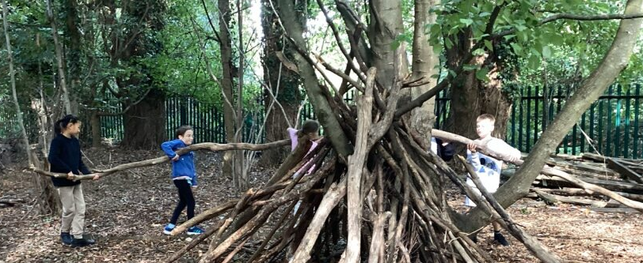
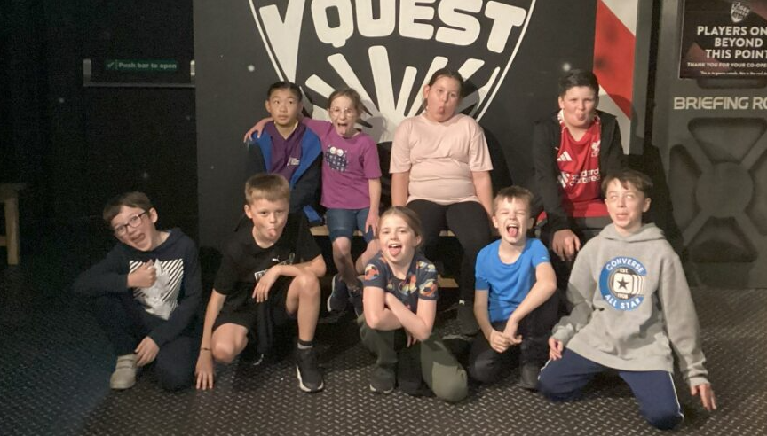
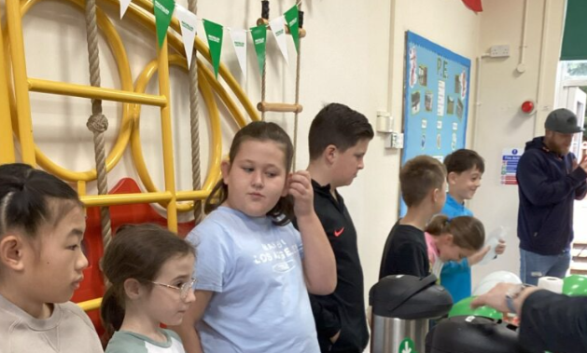
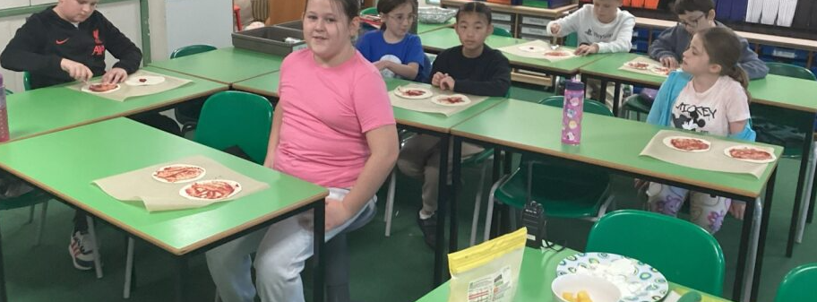

Slide 22
Next steps
A survey will be sent out to all parents to get feedback on the residential enrichment week for autumn 2027
This feedback, along with the pupil feedback, will help to inform our decision.
Parents will be notified of the option

