Slide 1

Open Parent Forum
Thursday 26th march 2026

Slide 2
Discussion items
Home Learning – school expectations
Ofsted – the New Framework
School uniform – next steps

Slide 3
Home learning

Slide 4
Home learning
The main focus of our home learning is fundamental English and mathematics with occasional tasks to extend and enhance learning from other subjects across the curriculum. We have prioritised reading as a key activity for each year group as it is important for our children to develop as fluent and proficient readers.
The timings given are a guideline and include time that you may spend with you reading to your child and discussing the text, developing their understanding of what they have read by asking questions as well as them practising to read the book we have sent home.

Slide 5
Home learning
Weekly Expectations
5 x per week to an adult or independently
Times Tables Rockstars – practice assigned times tables at least 3 x per week
Spelling Shed – practice assigned words using the games at least 3 x per week

Slide 6
Home learning
Other Expectations
Throughout the year, teachers may ask children to complete additional topic based learning to support their work in school. Expectations of this additional home learning will be shared with parents as appropriate
Parents may wish to explore other learning opportunities with their children at home. The curriculum for each year group outlines the expectations of content on a term-by-term basis and parents are welcome to use this to guide any additional learning at home.

Slide 7
Home learning
Engagement in home learning is monitored through looking at reading records and the online portals of TTRS and Spelling Shed.
Engagement is celebrated in class, lack of engagement is supported.
We do not want to create a culture of negativity towards learning, and acknowledge that all families, homes and out-of-school commitments are different.
We welcome families wanting to support learning at home in different ways – please do come and speak to us if you would like more support with this!

Slide 8
Ofsted framework - updates

Slide 9
New Framework – What it wants to Achieve
High-quality, inclusive education for every child, pupil, learner
Great outcomes for everyone, including for those who are disadvantaged, those with SEND, those known, or previously known to children’s social care
Better information for parents and carers
A collaborative and transparent approach to inspection
Rising standards of education and care.

Slide 10
Summary of changes
New report card
A five-point grading scale​
A renewed focus on inclusion

Slide 11

The focus on inclusion
Speaking with leaders about how pupils’ needs are identified and met.
Using discussions and IDSR information to understand the school’s context.
Case sampling to evaluate how support works in practice.
Learning walks to evaluate inclusion in action.

Slide 12

Ofsted will evaluate
Safeguarding (Met or Not Met)
Inclusion
Curriculum and teaching
Achievement
Attendance and behaviour
Personal development and well-being
Leadership and governance
A new five-point grading scale
Exceptional.
Strong standard.
Expected standard – OLD GOOD
Attention needed.
Urgent improvement.

Slide 13
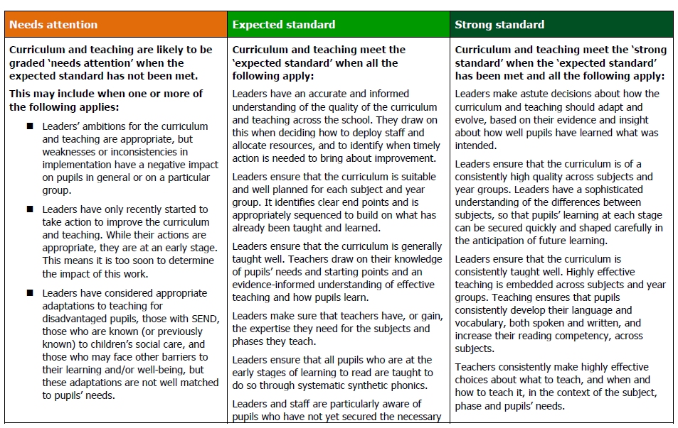
Grading
Grades Ofsted expect to see most frequently on inspection
Grades across a 5-point scale
Grading standards
Indicators

Slide 14
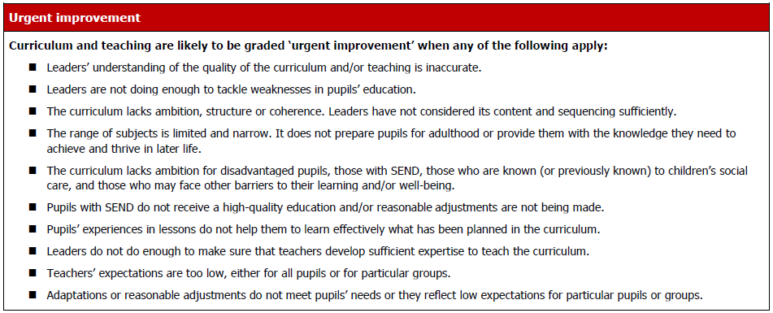
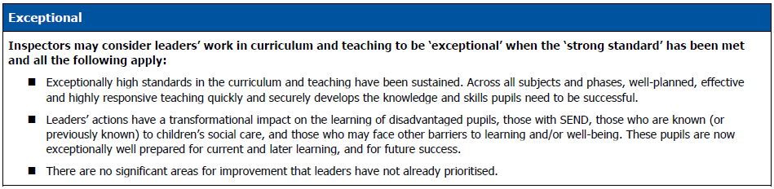
Toolkit
Grades we expect to see less frequently on inspection
Grades across a 5-point scale
Standards

Slide 15
School uniform
Next steps...

Slide 16
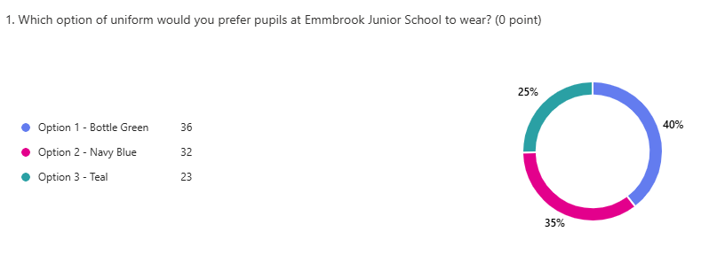
School uniform – next steps
And the survey says…
Parent feedback

Slide 17

School uniform – next steps
And the survey says…
Parent feedback

Slide 18


School uniform – next steps
And the survey says…
Pupil Feedback
107
41%
151
59%

Slide 19
Next steps
Earth Uniform will be using the new logo / colours on new uniform
This will be integrated into the school over the coming years, with no fixed end point for co-existing uniform.
Current uniform can continue to be worn / handed down as appropriate – only newly purchased uniform will be in new colours / logo.

