Slide 1
Open Parent Forum
Friday 12th December 2025

Slide 2
Discussion items
School Curriculum
Communication – what is working?
School uniform – Parent feedback

Slide 3

Ejs curriculum
Our curriculum is all available online through our website
Let’s have a look together…!

Slide 4

School communication
Weekly newsletter
Ad-hoc emails (e.g. about trips etc)
Admin phone calls (e.g. illness / absence)
Teacher phone calls (e.g. to discuss an incident)
Teachers on the playground at the end of the day

Slide 5
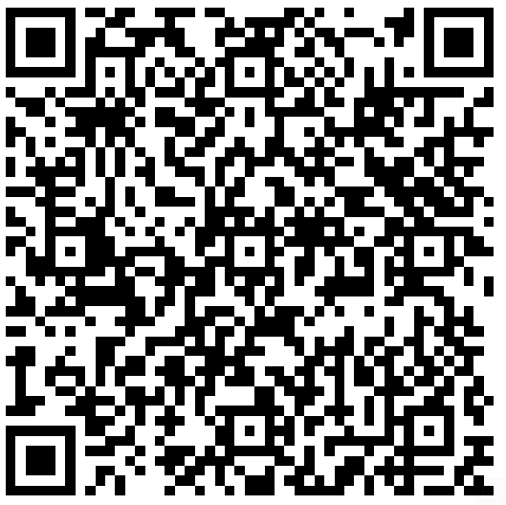
School communication
Time for a questionnaire!

Slide 6



School uniform – have your say!
New logo = new opportunity…
We would love to have your thoughts!

Slide 7
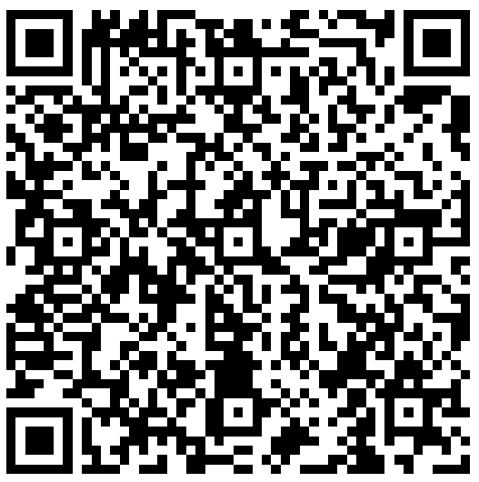
School uniform
Time for another questionnaire!

