Slide 1
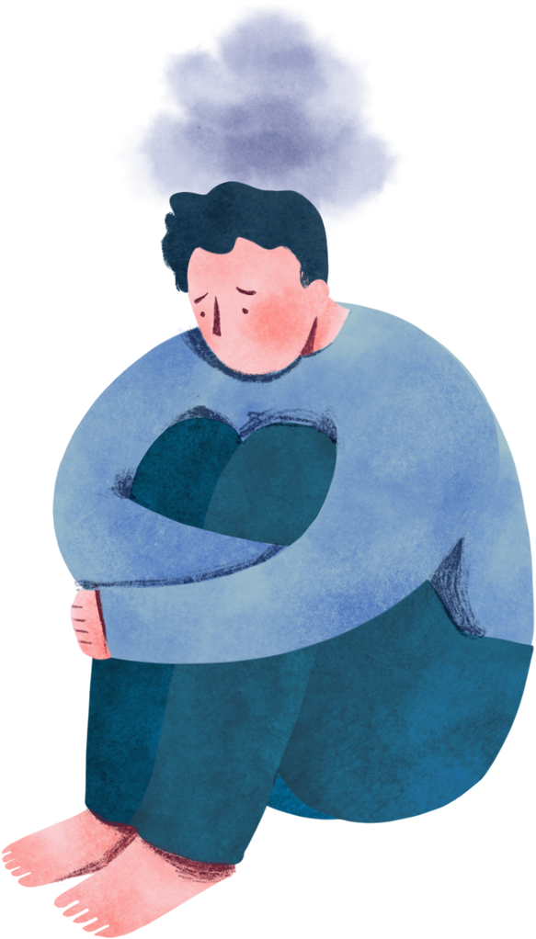
anxiety
An introduction to
parent workshop

Slide 2
Workshop aims:
Understand normal and problematic anxiety.
Identifying different types of problematic anxiety.
Understand factors that create and maintain anxiety.
Build confidence in spotting and managing factors that maintain anxiety.

Slide 3
What is anxiety?
Anxiety is a normal emotion that everyone will feel at some point in their lives. It can be difficult to control and can impact lives by making it difficult to do certain things.
Anxiety can affect many different aspects of an individuals life including: school, socially / friendships, sleep, emotions / mood, hobbies / activities and home life / family relationships.
However, anxiety can be helpful as it protects us when we’re in danger and can help us prepare for things. For example, if we’re standing near the edge of something without a barrier – the feeling of anxiety encourages us to move away and protect ourselves.

Slide 4
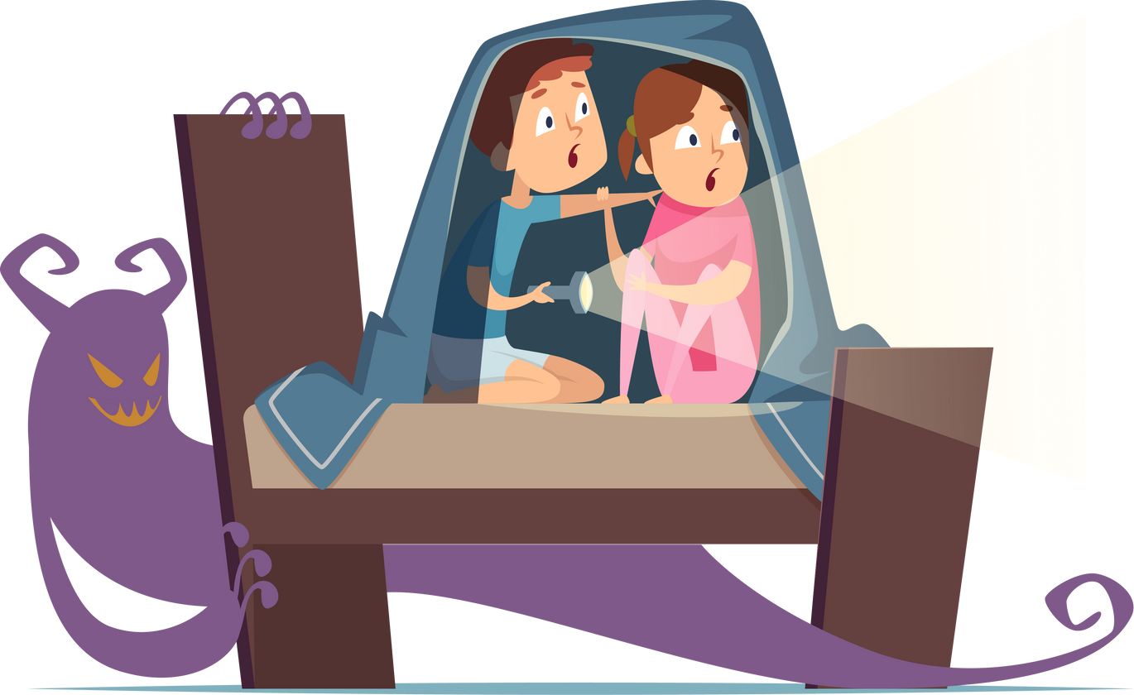
Anxiety in children
Not all childrens emotions are logical. Small children ordinarily have fears of the dark, insects, ghosts, kidnappers, getting lost or abandoned.
Such fears are common and normal in all children.
They will usually grow out of these fears but sometimes they persist as the child grows up.

Slide 5
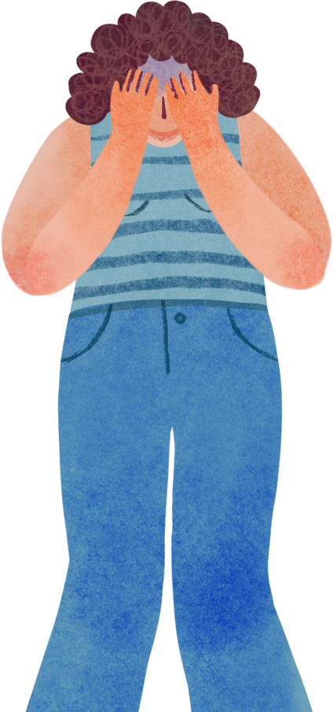
Reasons why a child might be anxious
Friendship issues
Diet
Illness
School - homework, underlying diagnosis, peer pressure, bullying, image, self-confidence
Specific fear - spiders, dogs, the dark
Inconsistent parenting
Changes to routines
Questioning sexuality
Hormones
Family issues - divorce, grief and loss, domestic abuse, parental health/mental health, finances
Normal changes - child to adolecence
Lack of sleep

Slide 6
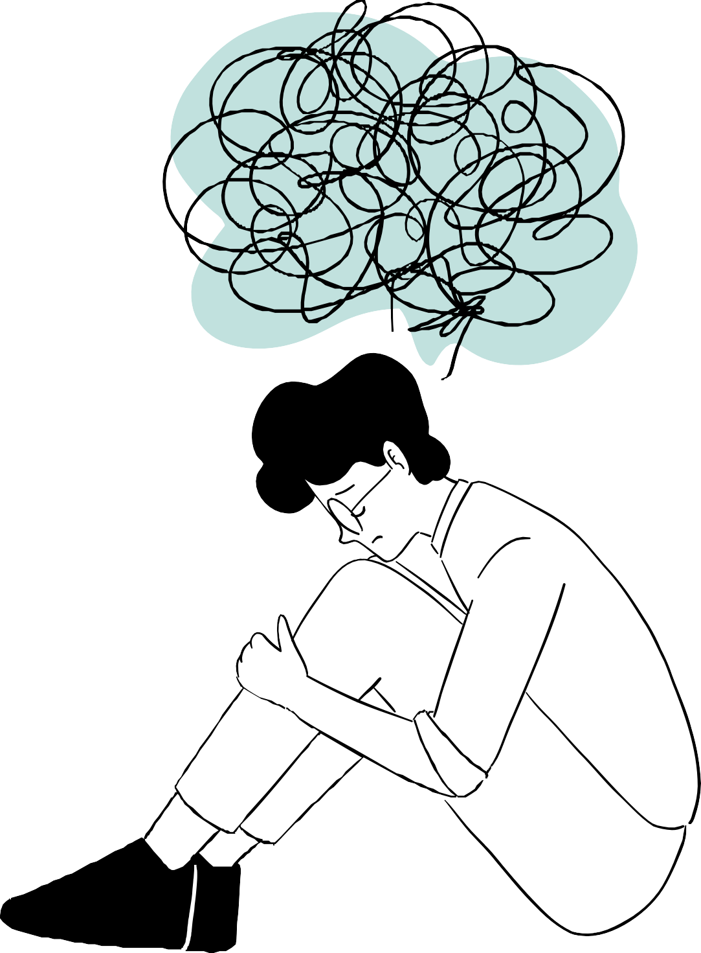
Common symptoms of anxiety
Muscle ache / tension
Noticeably fast, strong or irregular heart beat
Dry mouth
Feeling restless
Dizziness
Headaches
Frustration
Trembling
Feeling sick
Sweating
Feeling scared
Feeling overwhelmed or full of dread
Pins and needles
Feeling sad
Shaking
Difficulty concentrating
Panicky
Nervousness
Feeling frightened
Feeling irritable
Stomach ache

Slide 7
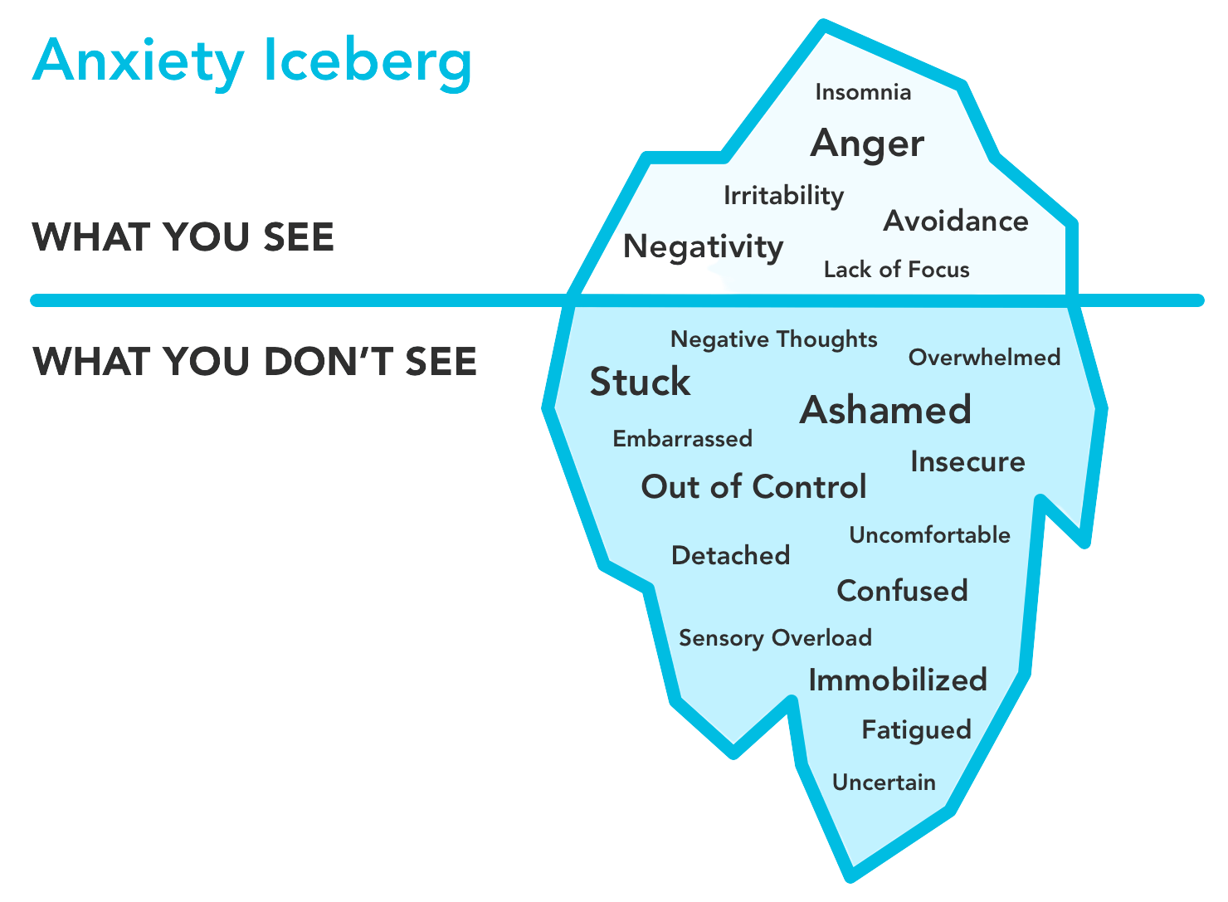
The Anxiety Iceberg illustrates what anxiety can look like on the outside, but shows that there is so much more going on underneath the surface.

Slide 8
Fight, flight, freeze
https://www.youtube.com/watch?v=rpolpKTWrp4
Humans developed the fight, flight, freeze automatic response as cave men as it was a much more dangerous time to live back then (think running away from saber tooth tigers and hunting for food).
The fight, flight, freeze response meant that cave men's bodies went into survival mode whenever their brains sensed danger. This meant their heart rate and blood pressure would increase so they had a better chance of running away or fighting the danger.
Even though we don't face the same dangers today, our brains and bodies still react in the same way to the things we perceive as dangerous, scary or worrying. This means our increased heart rate and blood pressure causes us to feel anxious.

Slide 9
Types of anxiety:
Generalised Anxiety
Phobia
Fear of specific things such as flying, small spaces, dogs - this can also lead to panic.
Panic
Thoughts of something bad happening, causing physical symptoms of anxiety such as hyperventilation, shaking and a fast heart rate. This can cause them to avoid certain places or situations for fear of having a panic attack.
Separation Anxiety
Worries about being away from family members or thinking something bad will happen to family. This can lead to not wanting to go to school or social events.
Social Anxiety
Fear of people judging them, thinking they are stupid or thinking that people will laugh at them in public places. This can also lead to avoid social situations and talking in front of others.
Excessive worry which seems uncontrollable. The worry interferes with your ability to relax, concentrate and enjoy activities.

Slide 10
What keeps anxiety going?
Behaviour:
When a child feels anxious, they can avoid certain situations/ places or ask for reassurance. These are called safety behaviours or unhelpful habits and whilst they can make them feel better, they can keep anxiety going.
Thoughts:
What children think about a situation or what they think is going to happen impacts on how they feel. Thinking in an anxious way, they tend to overestimate the likelihood of danger and underestimate their ability to cope with it.
Environment:
The surroundings or conditions in which children live can have an impact on how they feel. Ongoing stress or problems in their llives can keep problematic anxiety going for example, parental conflict or bullying.
Behaviour of others:
If those closest to a child get frustrated or upset when they are anxious, this can make a child feel more anxious.
Parents also need to be aware not to maintain anxiety by supporting a child to avoid situations as this will only keep anxiety going.

Slide 11
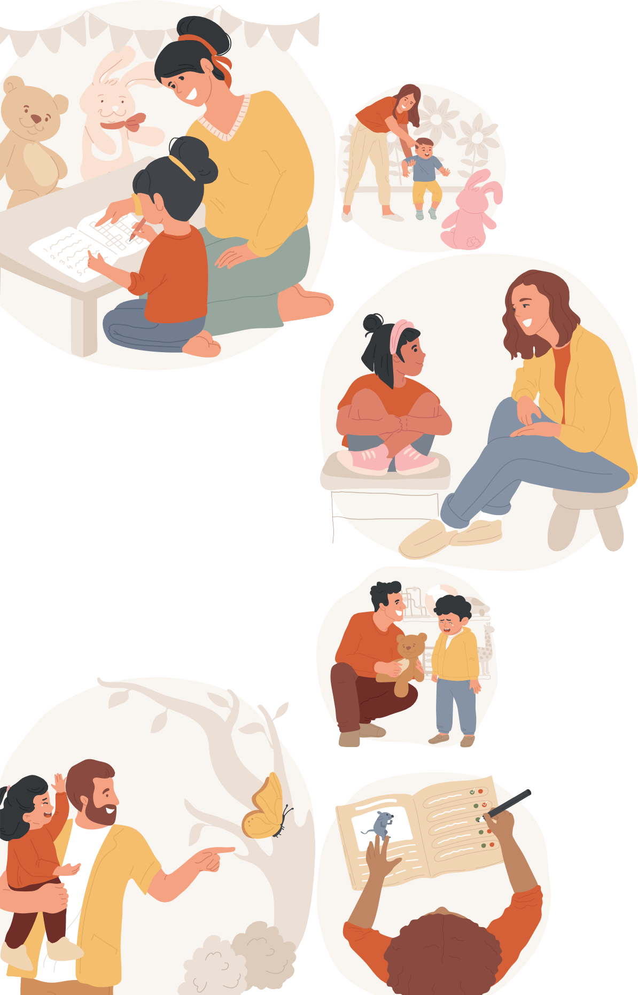
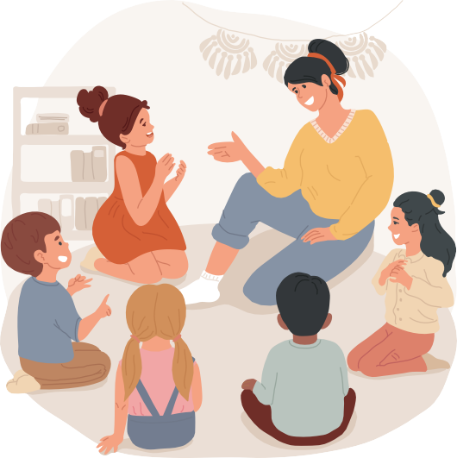
How to help your child
Talk to them.
Actively listen.
Encourage them to write their thoughts down. Support in exposure to the feared situation.
Relaxation/grounding techniques.

Slide 12
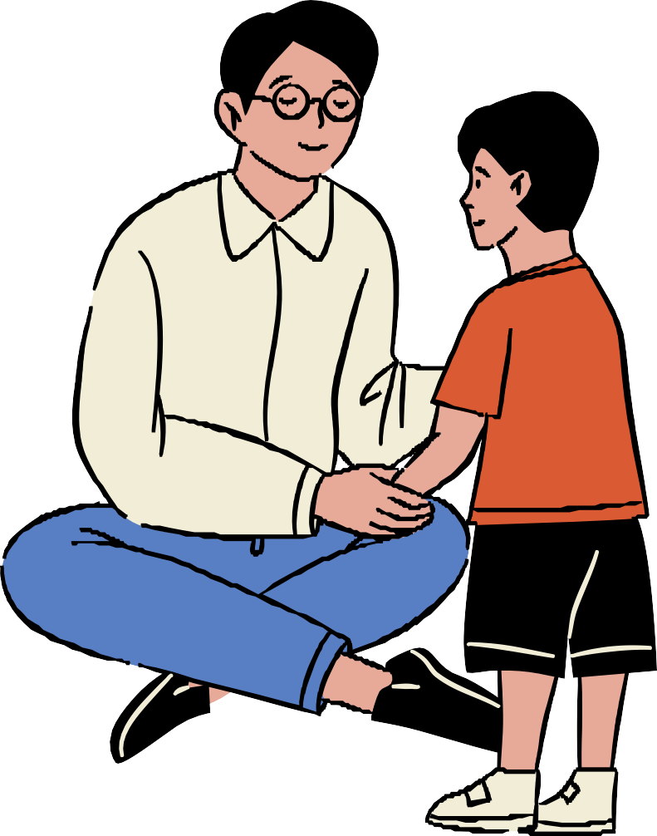
Tips on how to start conversations about mental health with your child
Be receptive
You look sad/upset today, do you want to have a chat/is there anything I can do?
I've got time to talk / would you like to go for a walk?
I noticed you seemed upset yesterday. I wanted to talk to you when we were alone. I'm really concerned about how you're doing.
Use open questions
I care about you and I've noticed you haven't been yourself lately. You seem more frustrated than you've been in a while, and I’m wondering how you're doing?
Tell me more, how did that make you feel?

Slide 13
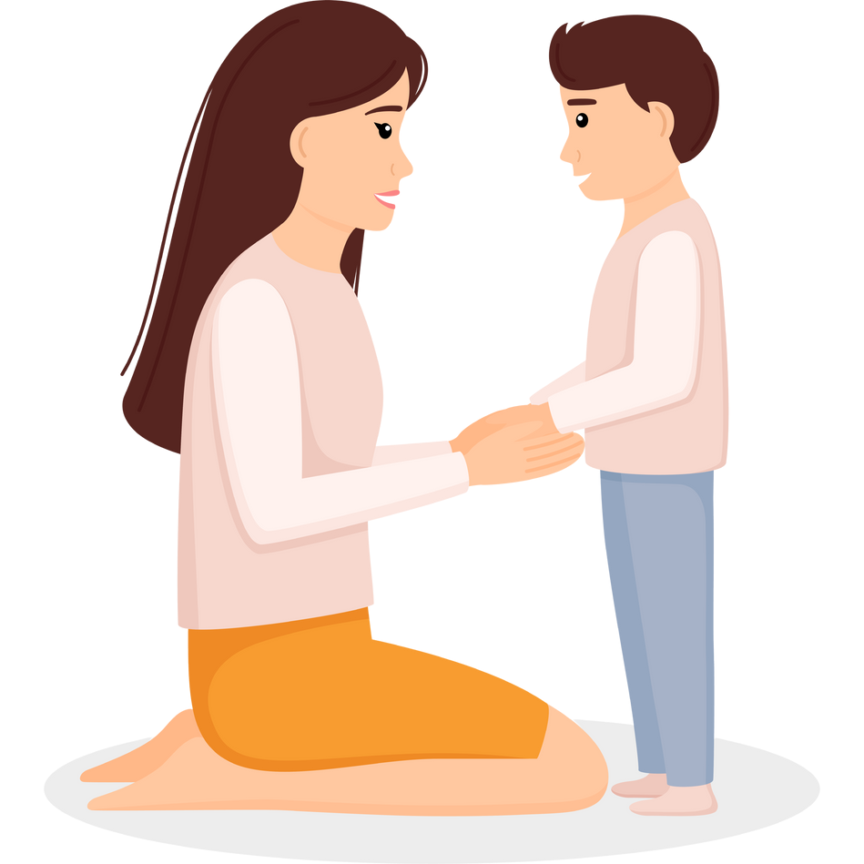
It is unhelpful to:
Pressure your child to 'snap out of it', 'get their act together' or 'cheer up'.
Tell them how lucky they are and they should be happy and grateful for what they have.
Tell them that you have real worries and dismiss theirs. Stay away or avoid them.
Assume the problem will go away and ignore it.

Slide 14
The importance of active listening
Listen to what the your child has to say without interrupting.
Be open-minded and non-judgemental.
Be patient - don't rush them or fill the gaps unnecessarily.
Avoid telling them what to do. Remove distractions - phones, TV etc.

Slide 15
Managing anxiety
Encouraging your child to write down their worries / anxious thoughts using a worry diary, worry box or container can help them to:
MY WORRY DIARY
THE SITUATION | THE WORRY / THOUGHTS | HOW WORRIED I
 |  | FEEL (0-10)
Have a physical way of 'getting rid' of their worries so they don't need to carry them around.
Create a routine for sorting out their worries and sharing them.
Help your child to understand their thoughts and know that it is possible to let them go.

Slide 16
The worry tree

Slide 17
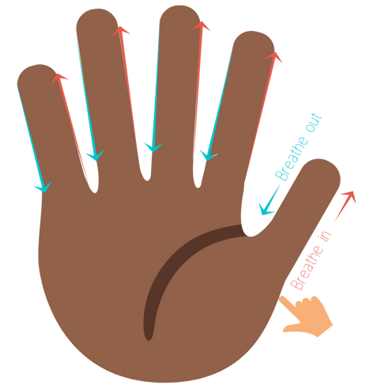
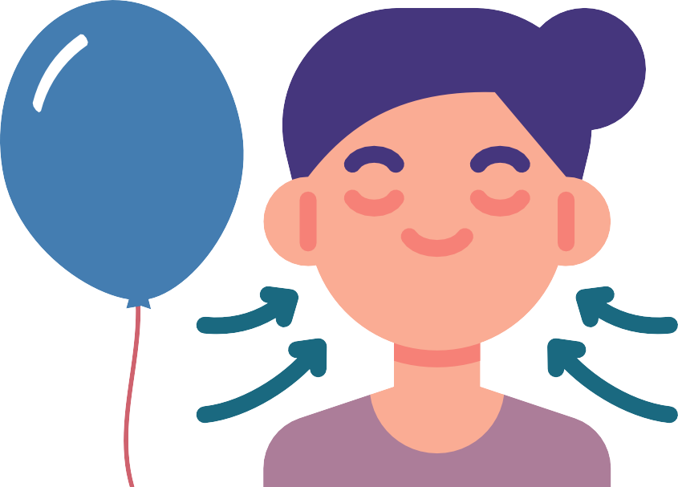
Breathing techniques
Finger breathing:
Use your index finger to trace around the edges of fingers on your opposite hand.
Count 1,2,3,4 and breath in as you go up the first finger.
Count 1,2,3,4 and breath out as you go down the finger.
Repeat until you have traced up and down all five fingers breathing in 1,2,3,4
and breathing out 1,2,3,4 each time.
Square breathing:
Belly breathing:
Take a deep breath in and fill your belly like you're inflating a balloon.
As you do this, count 1, 2, 3, 4 to breath in and fill the balloon in your belly.
Pause and then let all of the air out of your belly like you're
letting a balloon deflate.
As you do this, count 1, 2, 3, 4 to breath out and let the balloon go down from your
belly.
Imagine you are drawing a square with your finger in the air.
Breathe in whilst counting 1,2,3,4 as you draw the top line and then pause.
Breathe out whilst counting 1,2,3,4 as you draw the line down the side and then
pause.
Breathe in whilst counting 1,2,3,4 as you draw the bottom line and then pause.
Breathe out whilst counting 1,2,3,4 as you draw the line up to complete the square
and then pause.
Hold - 4 seconds
Exhale - 4 seconds
Inhale - 4 seconds
Hold - 4 seconds

Slide 18
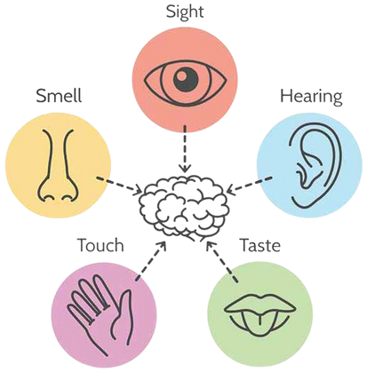
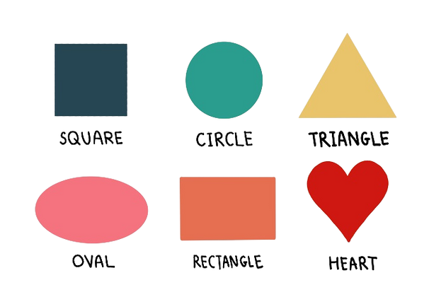
Calming techniques
5, 4, 3, 2, 1:
Search the room:
Stating facts:
Take notice of your senses by thinking of:
5 things you can see,
4 things you can hear,
3 things you can feel/touch,
2 things you can smell,
1 thing you can taste.
Think of a category and search the room for it. For example, look for:
Everything that is a ... colour,
Everything that is a ... shape,
Things that feel of...
Things made of...
Think about and name facts about what is going on right now. For example, think:
My age is...
My name is...
I am wearing...
The weather is...

Slide 19
Additional support
116 123
01494463364
✉Text: SHOUT to 85258
CAMHS CPE
0300 365 1234
Wokingham Emotional Wellbeing Hub
0118 974 6000
www.youngminds.org.uk
08001337938

Slide 20
Thank you

